Slide 1

Lab 1
ECTE250 - UOWD
Habiba Ahmed, Eva Barbulescu, Sana Sahir, Ashna Sreejith

Slide 2
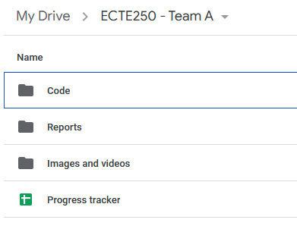
Team setup
All members must contribute to technical and report work
Pick a team leader and create a google drive folder with your group name
Your google drive must have the following subfolders
Add kiyan.afsari@gmail.com/nejad1223@gmail.com as editor
The progress tracker is the evidence of your work, you must work on the google drive folder, else your progress will not be considered

Slide 3
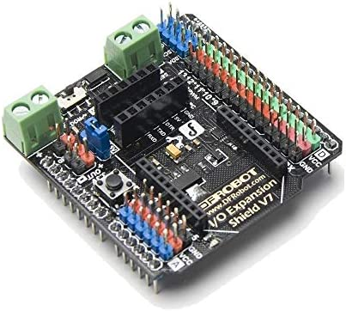
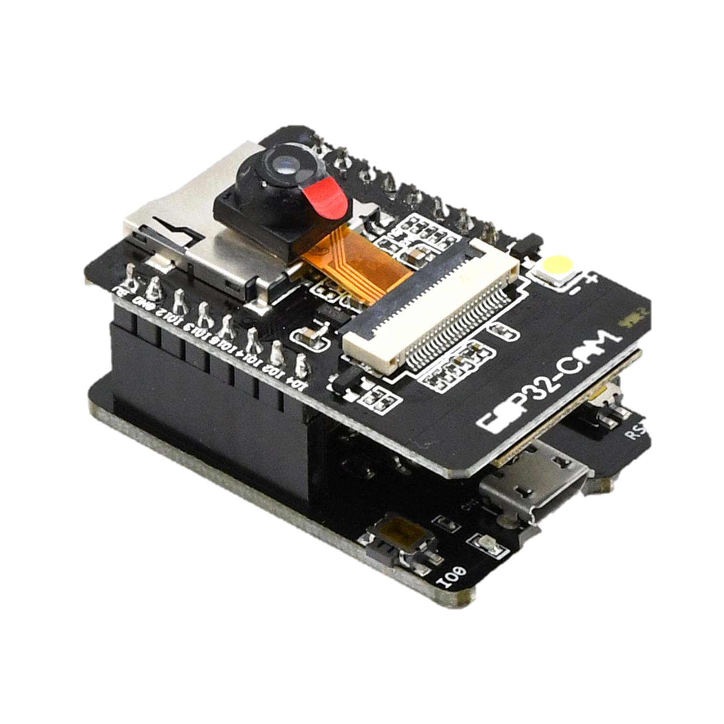
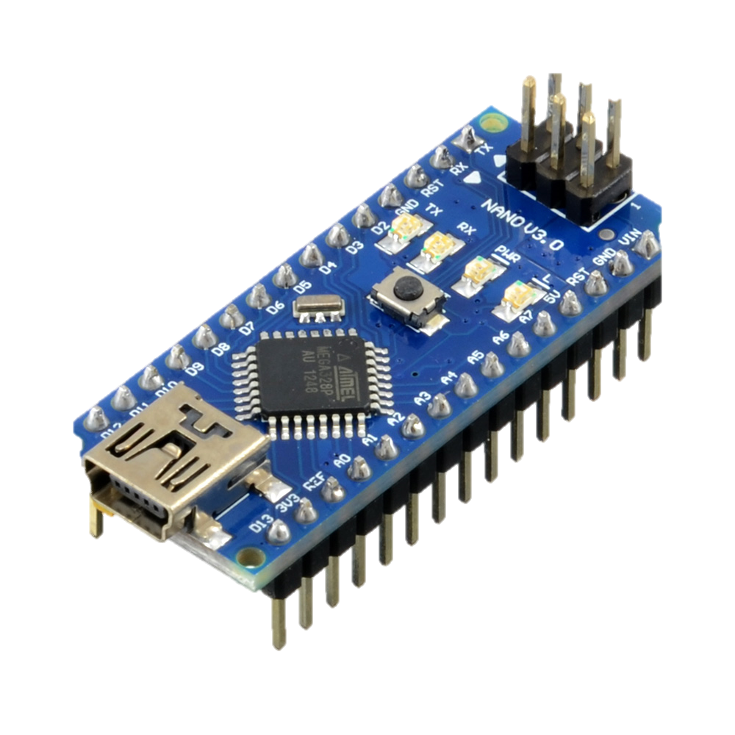
Workshop 1
This course is based on Arduino systems
You can use any version of Arduino or clones such as ESP32, Romeo BLE
For now we will use an Arduino simulator called tinkerCad
Register at: https://www.tinkercad.com/

Slide 4
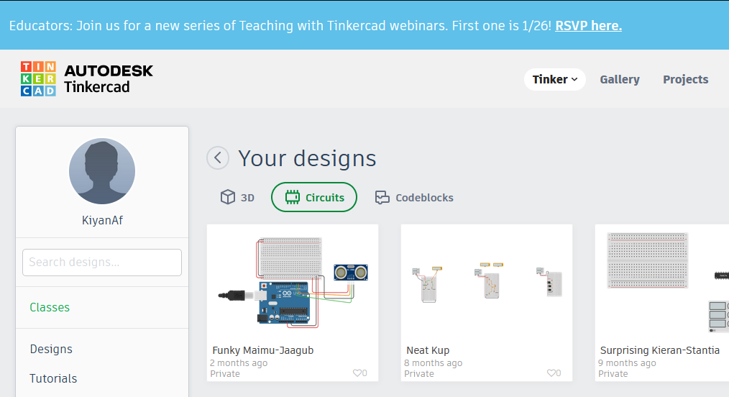
Task 1 Blink an led
Log in to your account and create a blank circuit
From the top right menu drag and drop an Arduino with a breadboard and an LED
Connect the LED on the breadboard and connect it to pin D13 of Arduino
Write your very first Arduino program to blink the LED

Slide 5
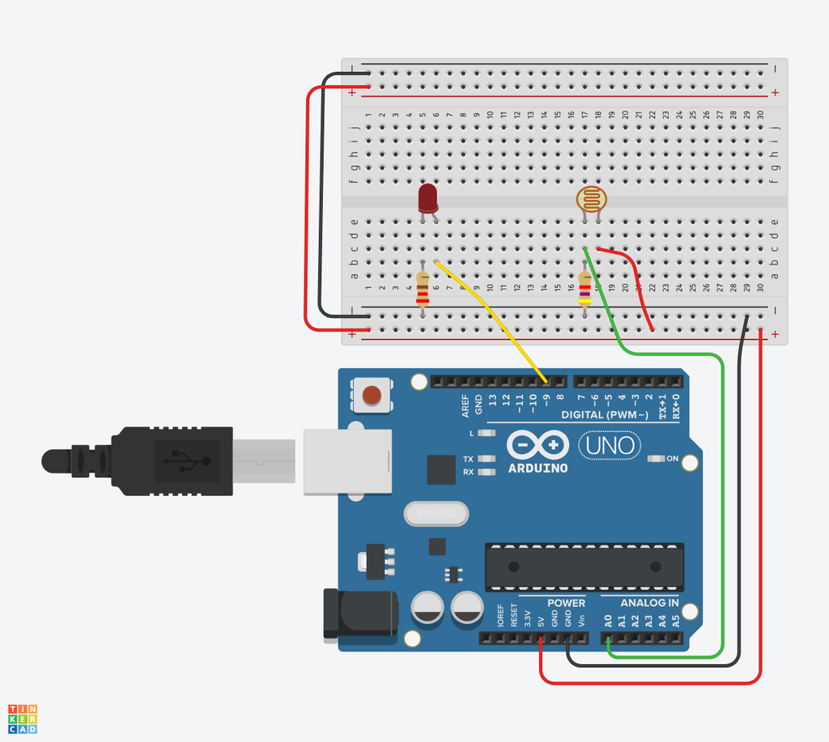
Task 2
Add a photoresistor (LDR) to your circuit. This sensor measure the amount of light available in the room.
The circuitry is given in the figure on the right
Add the necessary logic in your code to blink the LED when the light intensity is above 500, and keep the light on when the intensity is below 500

Slide 6
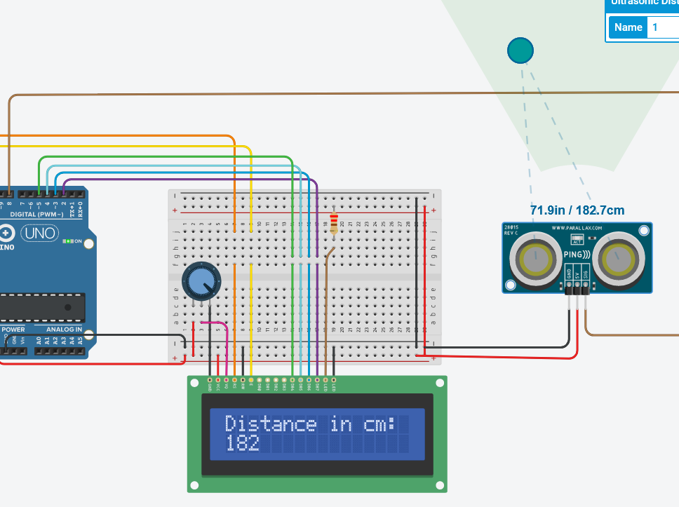
Task 3
Drag and drop the Arduino with LCD attached
Drag and drop and ultrasonic and integrate it with your system
Your LCD should display the distance measured in cm

Slide 7
submission
Your workshop 1 will be submitted individually through moodle quizzes
Please complete the MCQ quiz on moodle

